Slide 1
Deep neural networks

Slide 2
Outline
What’s new in ANNs in the last 5-10 years?
Deeper networks, more data, and faster training
Scalability and use of GPUs ✔
Symbolic differentiation
reverse-mode automatic differentiation
“Generalized backprop”
Some subtle changes to cost function, architectures, optimization methods ✔
What types of ANNs are most successful and why?
Convolutional networks (CNNs)
Long term/short term memory networks (LSTM)
Word2vec and embeddings
What are the hot research topics for deep learning?

Slide 3
Outline
What’s new in ANNs in the last 5-10 years?
Deeper networks, more data, and faster training
Scalability and use of GPUs ✔
Symbolic differentiation
reverse-mode automatic differentiation
“Generalized backprop”
Some subtle changes to cost function, architectures, optimization methods ✔
What types of ANNs are most successful and why?
Convolutional networks (CNNs)
Long term/short term memory networks (LSTM)
Word2vec and embeddings
What are the hot research topics for deep learning?

Slide 4
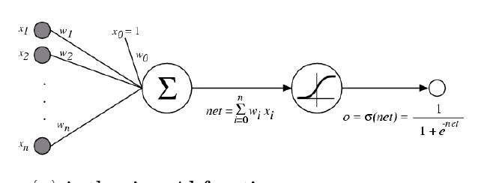
Recap: multilayer networks
Classifier is a multilayer network of logistic units
Each unit takes some inputs and produces one output using a logistic classifier
Output of one unit can be the input of another
Input layer
Hidden layer
Output layer
1
w^{0,1}
w^{0,2}
w^{1,1}
v¹=S(w^{T}X)
w¹
w^{2,1}
x¹
z¹=S(w^{T}V)
w^{1,2}
w²
x²
w^{2,2}
v²=S(w^{T}X)

Slide 5
Recap: Learning a multilayer network
Define a loss which is squared error
over a network of logistic units
Minimize loss with gradient descent
output is network output

Slide 6
Recap: weight updates for multilayer ANN
How can we generalize BackProp to other ANNs?
For nodes k in output layer:
“Propagate errors backward”
BACKPROP
For nodes j in hidden layer:
Can carry this recursion out further if you have multiple hidden layers
For all weights:

Slide 7
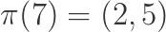
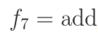
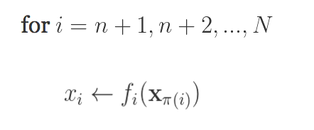
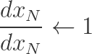
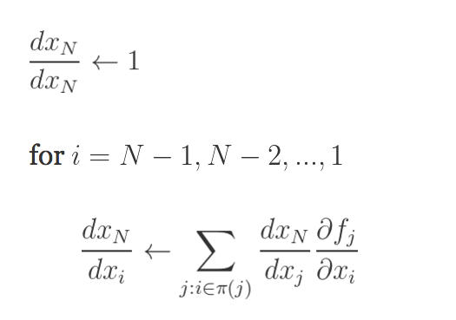
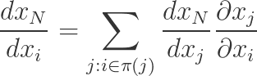
Generalizing backprop
https://justindomke.wordpress.com/
e.g.
Starting point: a function of n variables
Step 1: code your function as a series of assignments
Step 2: back propagate by going thru the list in reverse order, starting with…
…and using the chain rule
Step 1: forward
Wengert list
inputs:
return
Step 1: backprop
A function
Computed in previous step

Slide 8
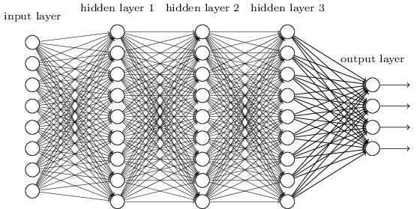
Recap: logistic regression with SGD
Let X be a matrix with k examples
Let w_{i} be the input weights for the i-th hidden unit
Then Z = X W is output (pre-sigmoid) for all m units
for all k examples
w₁ | w₂ | w₃ | … | w_{m}
0.1 | -0.3 | …
-1.7 | …
0.3 | …
1.2
x₁ | 1 | 0 | 1 | 1
x₂ | …
…
x_{k}
There’s a lot of chances to do this in parallel…. with parallel matrix multiplication
x₁.w₁ | x₁.w₂ | … | x₁.w_{m}
x_{k}.w₁ | … | … | x_{k}.w_{m}
XW =

Slide 9
Example: 2-layer neural network
Step 1: forward
Step 1: backprop
inputs:
return
X is N*D, W1 is D*H, B1 is 1*H, W2 is H*K, …
Inputs: X,W1,B1,W2,B2
Z1a = mul(X,W1) // matrix mult
Z1b = add*(Z1a,B1) // add bias vec
A1 = tanh(Z1b) //element-wise
Z2a = mul(A1,W2)
Z2b = add*(Z2a,B2)
A2 = tanh(Z2b) // element-wise
P = softMax(A2) // vec to vec
C = crossEnt_{Y}(P) // cost function
Z1a is N*H
Z1b is N*H
A1 is N*H
Z2a is N*K
Z2b is N*K
A2 is N*K
P is N*K
C is a scalar
Target Y; N examples; K outs; D feats, H hidden

Slide 10
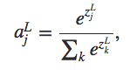
Example: 2-layer neural network
Step 1: forward
Step 1: backprop
inputs:
return
dC/dC = 1
dC/dP = dC/dC * dCrossEnt_{Y}/dP
dC/dA2 = dC/dP * dsoftmax/dA2
dC/Z2b = dC/dA2 * dtanh/dZ2b
dC/dZ1a = dC/dZ2b * (dadd*/dZ2a + dadd/dB2)
dC/dB2 = dC/Z2b * 1
dC/dZ2a = dC/dZ2b * (dmul/dA1 + dmul/dW2)
dC/dW2 = dC/dZ2a * 1
dC/dA1 = …
N*K
Inputs: X,W1,B1,W2,B2
Z1a = mul(X,W1) // matrix mult
Z1b = add*(Z11,B1) // add bias vec
A1 = tanh(Z1b) //element-wise
Z2a = mul(A1,W2)
Z2b = add*(Z2a,B2)
A2 = tanh(Z2b) // element-wise
P = softMax(A2) // vec to vec
C = crossEnt_{Y}(P) // cost function
(N*K) * (K*K)
(N*K)
N*H
Target Y; N rows; K outs; D feats, H hidden

Slide 11
Example: 2-layer neural network
Step 1: forward
Step 1: backprop
inputs:
return
dC/dC = 1
dC/dP = dC/dC * dCrossEnt_{Y}/dP
dC/dA2 = dC/dP * dsoftmax/dA2
dC/Z2b = dC/dA2 * dtanh/dZ2b
dC/dZ1a = dC/dZ2b * (dadd/dZ2a + dadd/dB2)
dC/dB2 = dC/Z2b * 1
dC/dZ2a = dC/dZ2b * (dmul/dA1 + dmul/dW2)
dC/dW2 = dC/dZ2a * 1
dC/dA1 = …
N*K
Inputs: X,W1,B1,W2,B2
Z1a = mul(X,W1) // matrix mult
Z1b = add(Z11,B1) // add bias vec
A1 = tanh(Z1b) //element-wise
Z2a = mul(A1,W2)
Z2b = add(Z2a,B2)
A2 = tanh(Z2b) // element-wise
P = softMax(A2) // vec to vec
C = crossEnt_{Y}(P) // cost function
N*H
Need a backward form for each matrix operation used in forward
Target Y; N rows; K outs; D feats, H hidden

Slide 12
Example: 2-layer neural network
Step 1: forward
Step 1: backprop
inputs:
return
dC/dC = 1
dC/dP = dC/dC * dCrossEnt_{Y}/dP
dC/dA2 = dC/dP * dsoftmax/dA2
dC/Z2b = dC/dA2 * dtanh/dZ2b
dC/dZ1a = dC/dZ2b * (dadd/dZ2a + dadd/dB2)
dC/dB2 = dC/Z2b * 1
dC/dZ2a = dC/dZ2b * (dmul/dA1 + dmul/dW2)
dC/dW2 = dC/dZ2a * 1
dC/dA1 = …
N*K
Inputs: X,W1,B1,W2,B2
Z1a = mul(X,W1) // matrix mult
Z1b = add(Z11,B1) // add bias vec
A1 = tanh(Z1b) //element-wise
Z2a = mul(A1,W2)
Z2b = add(Z2a,B2)
A2 = tanh(Z2b) // element-wise
P = softMax(A2) // vec to vec
C = crossEnt_{Y}(P) // cost function
N*H
Need a backward form for each matrix operation used in forward, with respect to each argument
Target Y; N rows; K outs; D feats, H hidden

Slide 13
Example: 2-layer neural network
Step 1: forward
inputs:
An autodiff package usually includes
A collection of matrix-oriented operations (mul, add*, …)
For each operation
A forward implementation
A backward implementation for each argument
It’s still a little awkward to program with a list of assignments so….
return
Inputs: X,W1,B1,W2,B2
Z1a = mul(X,W1) // matrix mult
Z1b = add(Z11,B1) // add bias vec
A1 = tanh(Z1b) //element-wise
Z2a = mul(A1,W2)
Z2b = add(Z2a,B2)
A2 = tanh(Z2b) // element-wise
P = softMax(A2) // vec to vec
C = crossEnt_{Y}(P) // cost function
N*H
Need a backward form for each matrix operation used in forward, with respect to each argument
Target Y; N rows; K outs; D feats, H hidden

Slide 14
Generalizing backprop
https://justindomke.wordpress.com/
Step 1: forward
Starting point: a function of n variables
Step 1: code your function as a series of assignments
inputs:
Wengert list
return
Better plan: overload your matrix operators so that when you use them in-line they build an expression graph
Convert the expression graph to a Wengert list when necessary

Slide 15
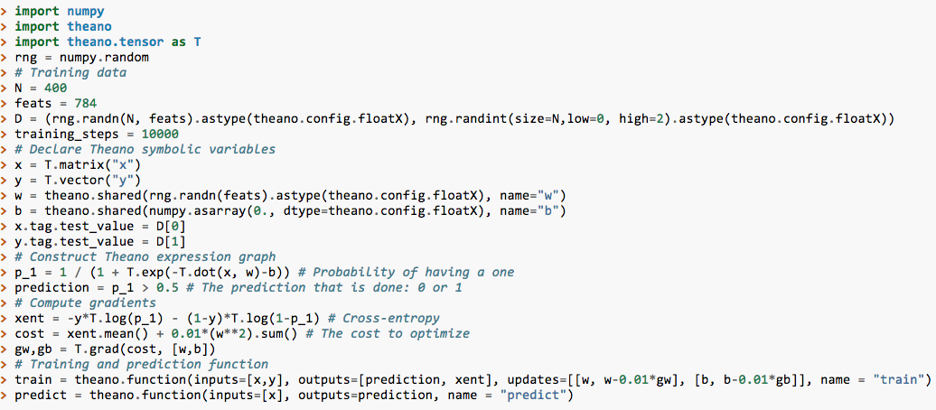
Example: Theano
… # generate some training data

Slide 16
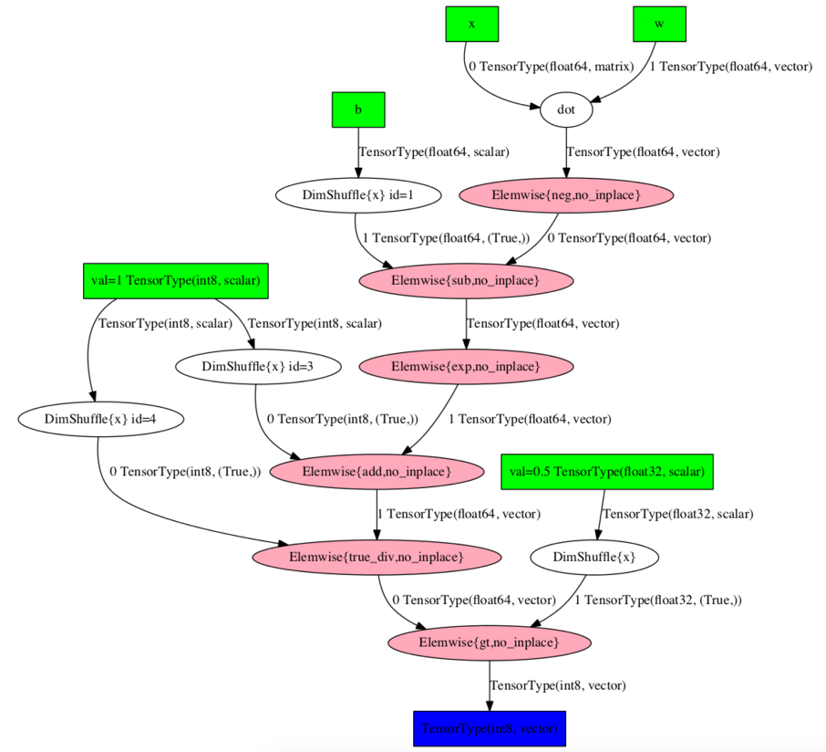
Example: Theano

Slide 17
p_1

Slide 18
Example: 2-layer neural network
Step 1: forward
inputs:
An autodiff package usually includes
A collection of matrix-oriented operations (mul, add*, …)
For each operation
A forward implementation
A backward implementation for each argument
A way of composing operations into expressions (often using operator overloading) which evaluate to expression trees
Expression simplification/compilation
return
Inputs: X,W1,B1,W2,B2
Z1a = mul(X,W1) // matrix mult
Z1b = add(Z11,B1) // add bias vec
A1 = tanh(Z1b) //element-wise
Z2a = mul(A1,W2)
Z2b = add(Z2a,B2)
A2 = tanh(Z2b) // element-wise
P = softMax(A2) // vec to vec
C = crossEnt_{Y}(P) // cost function
N*H

Slide 19
Some tools that use autodiff
Theano:
Univ Montreal system, Python-based, first version 2007 now v0.8, integrated with GPUs
Many libraries build over Theano (Lasagne, Keras, Blocks..)
Torch:
Collobert et al, used heavily at Facebook, based on Lua. Similar performance-wise to Theano
TensorFlow:
Google system, possibly not well-tuned for GPU systems used by academics
Also supported by Keras
Autograd
New system which is very Pythonic, doesn’t support GPUs (yet)
…

Slide 20
Outline
What’s new in ANNs in the last 5-10 years?
Deeper networks, more data, and faster training
Scalability and use of GPUs ✔
Symbolic differentiation ✔
Some subtle changes to cost function, architectures, optimization methods ✔
What types of ANNs are most successful and why?
Convolutional networks (CNNs)
Long term/short term memory networks (LSTM)
Word2vec and embeddings
What are the hot research topics for deep learning?

Slide 21
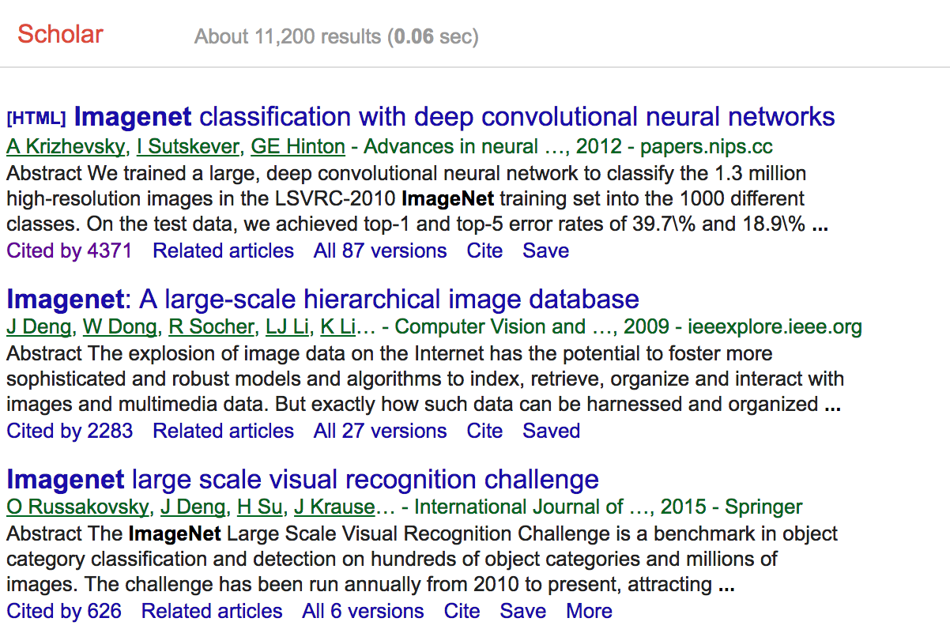

Slide 22
What’s a Convolutional Neural Network?

Slide 23
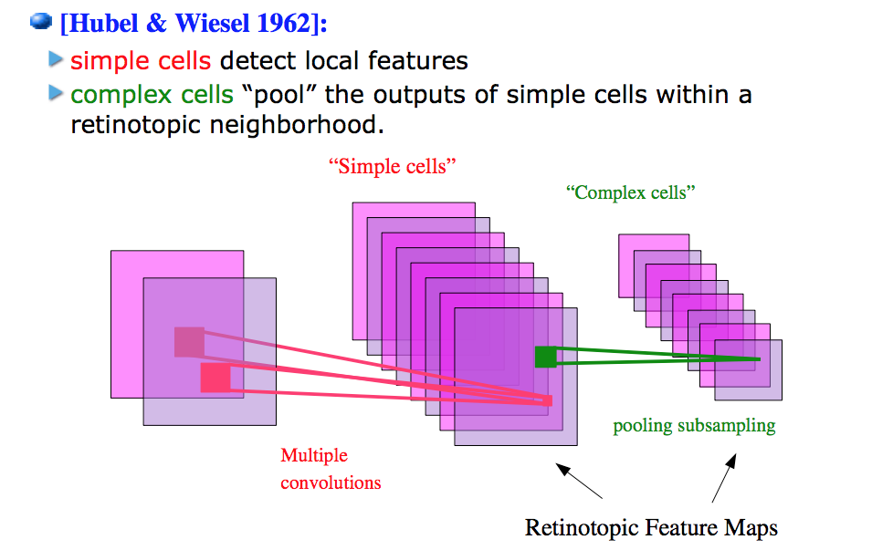
Model of vision in animals

Slide 24
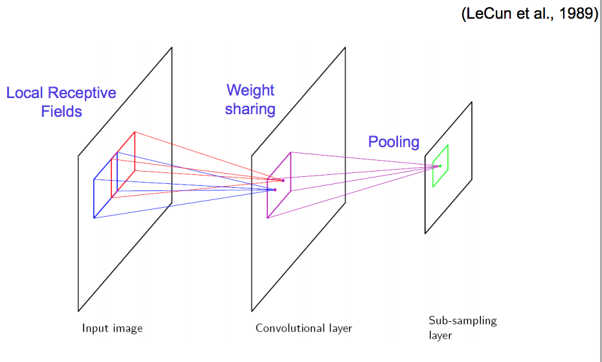
Vision with ANNs

Slide 25
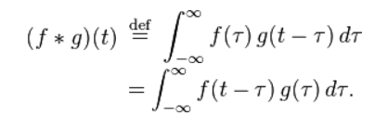
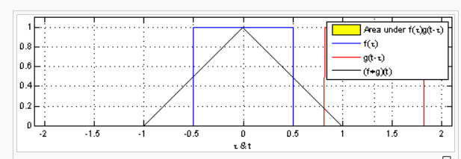
What’s a convolution?
https://en.wikipedia.org/wiki/Convolution
1-D

Slide 26
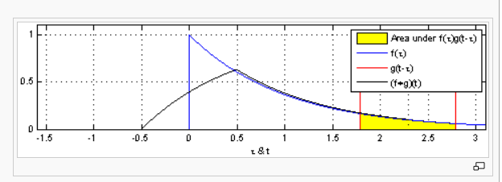
What’s a convolution?
https://en.wikipedia.org/wiki/Convolution
1-D

Slide 27
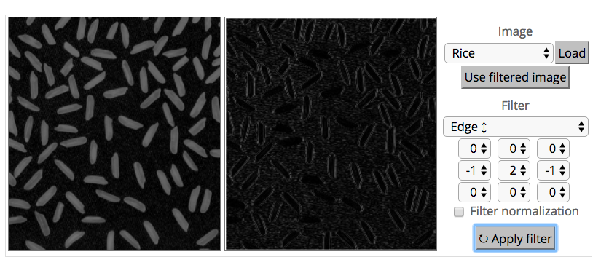
What’s a convolution?
http://matlabtricks.com/post-5/3x3-convolution-kernels-with-online-demo

Slide 28
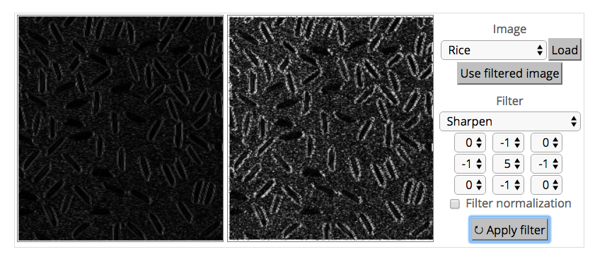
What’s a convolution?
http://matlabtricks.com/post-5/3x3-convolution-kernels-with-online-demo

Slide 29
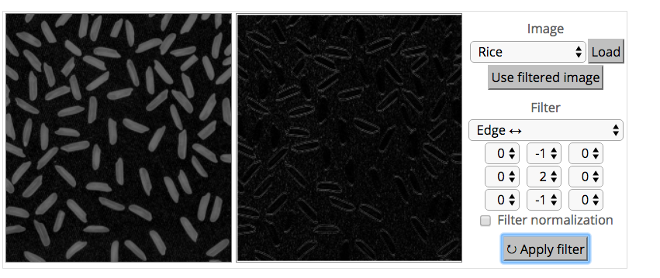
What’s a convolution?
http://matlabtricks.com/post-5/3x3-convolution-kernels-with-online-demo

Slide 30
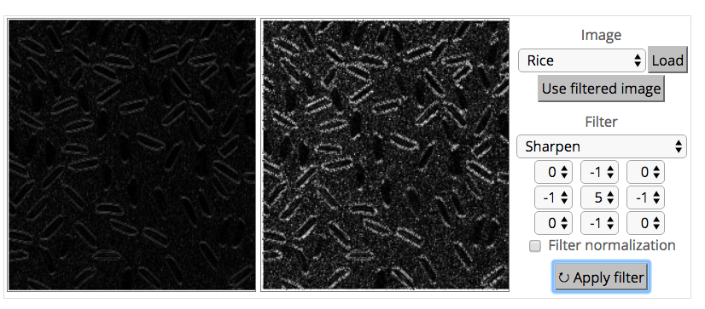
What’s a convolution?
http://matlabtricks.com/post-5/3x3-convolution-kernels-with-online-demo

Slide 31
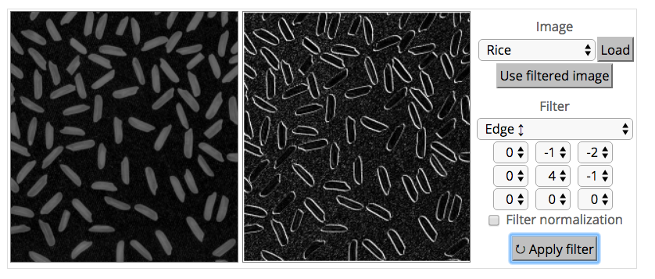
What’s a convolution?
http://matlabtricks.com/post-5/3x3-convolution-kernels-with-online-demo

Slide 32
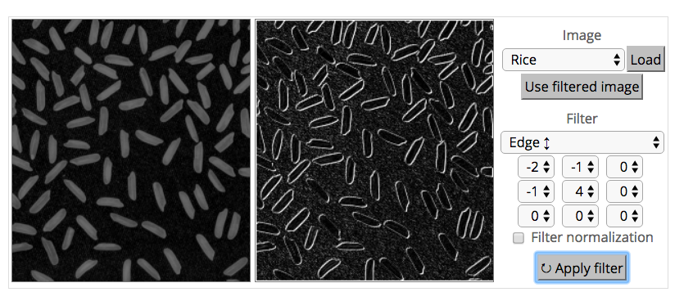
What’s a convolution?
http://matlabtricks.com/post-5/3x3-convolution-kernels-with-online-demo

Slide 33
What’s a convolution?
Basic idea:
Pick a 3x3 matrix F of weights
Slide this over an image and compute the “inner product” (similarity) of F and the corresponding field of the image, and replace the pixel in the center of the field with the output of the inner product operation
Key point:
Different convolutions extract different types of low-level “features” from an image
All that we need to vary to generate these different features is the weights of F

Slide 34
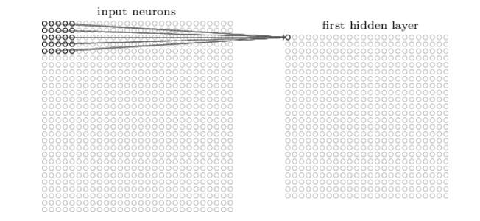
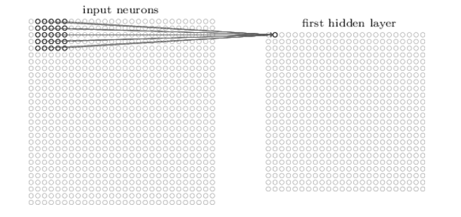
How do we convolve an image with an ANN?
Note that the parameters in the matrix defining the convolution are tied across all places that it is used

Slide 35
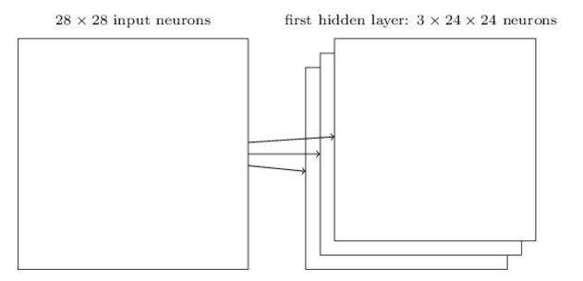
How do we do many convolutions of an image with an ANN?

Slide 36
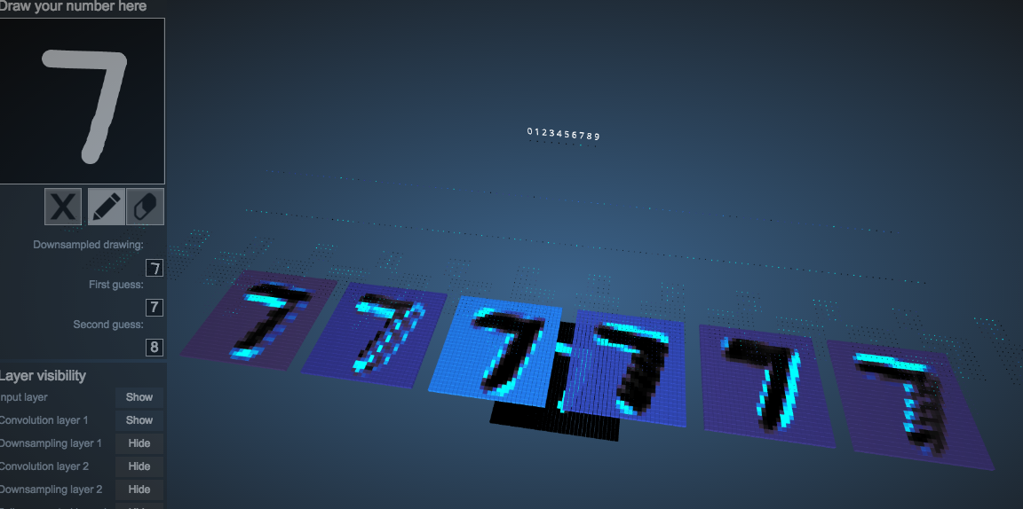

Example: 6 convolutions of a digit
http://scs.ryerson.ca/~aharley/vis/conv/

Slide 37
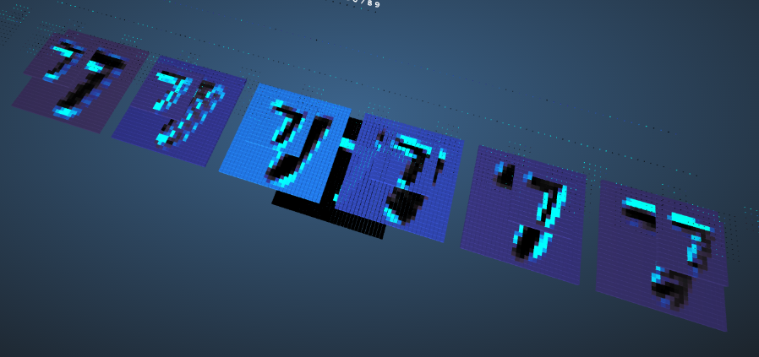
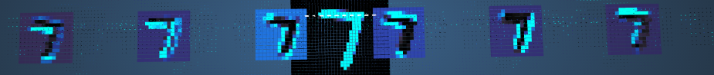
CNNs typically alternate convolutions, non-linearity, and then downsampling
Downsampling is usually averaging or (more common in recent CNNs) max-pooling

Slide 38
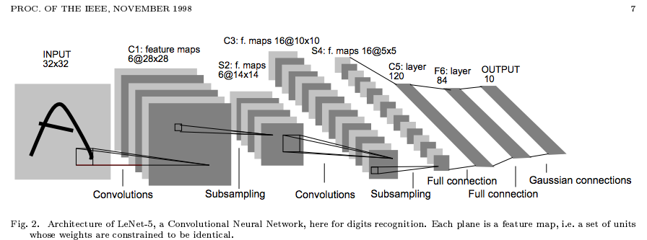
Why do max-pooling?
Saves space
Reduces overfitting?
Because I’m going to add more convolutions after it!
Allows the short-range convolutions to extend over larger subfields of the images
So we can spot larger objects
Eg, a long horizontal line, or a corner, or …

Slide 39
Another CNN visualization
https://cs.stanford.edu/people/karpathy/convnetjs/demo/mnist.html

Slide 40
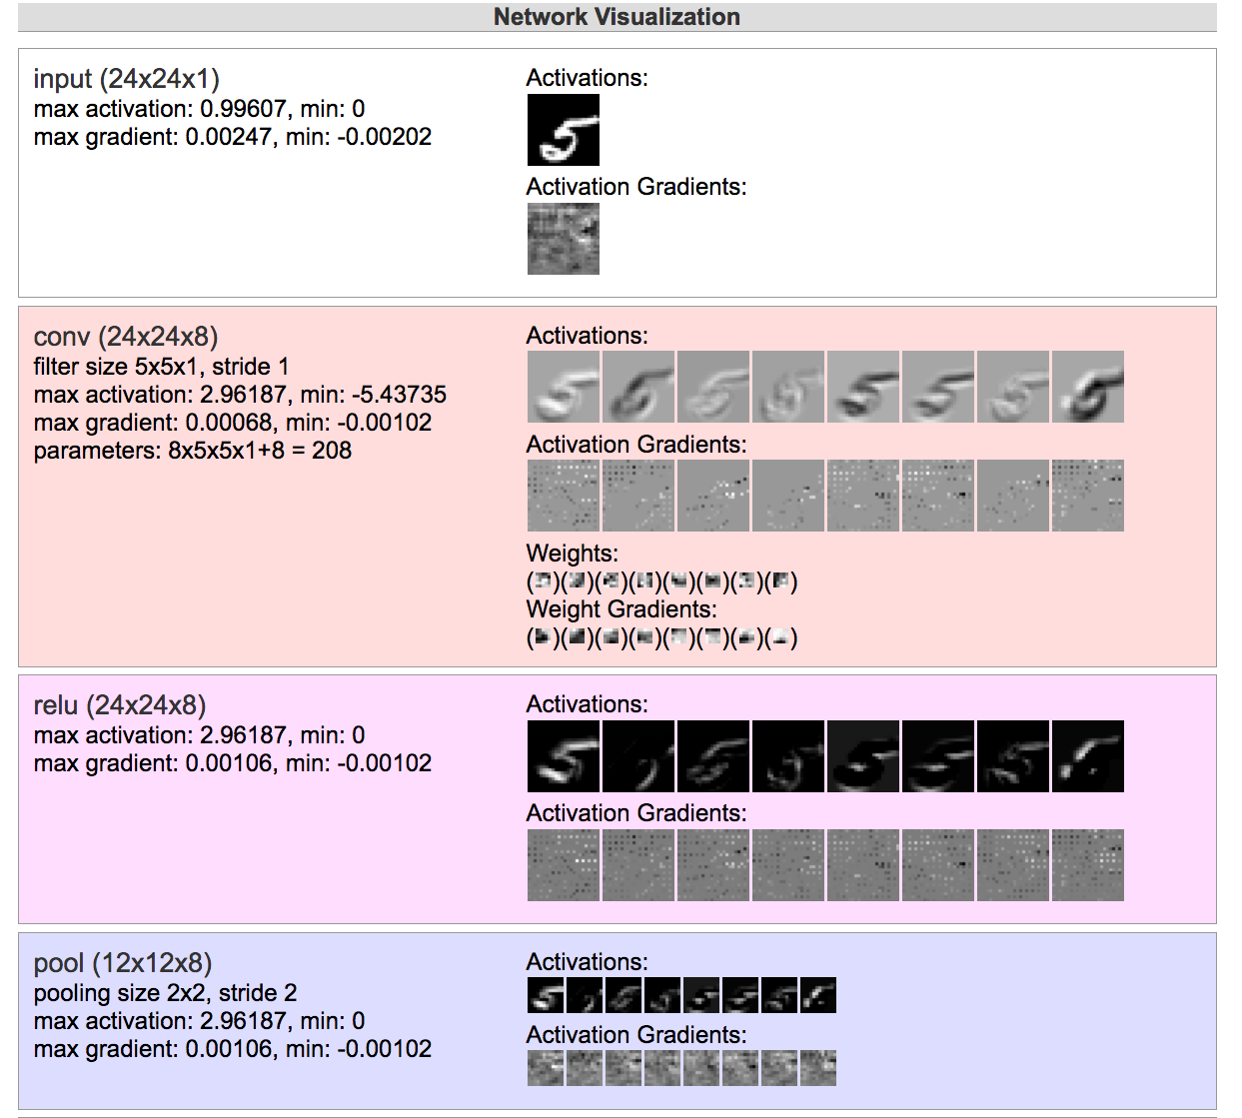
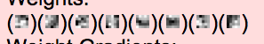
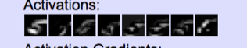

Slide 41
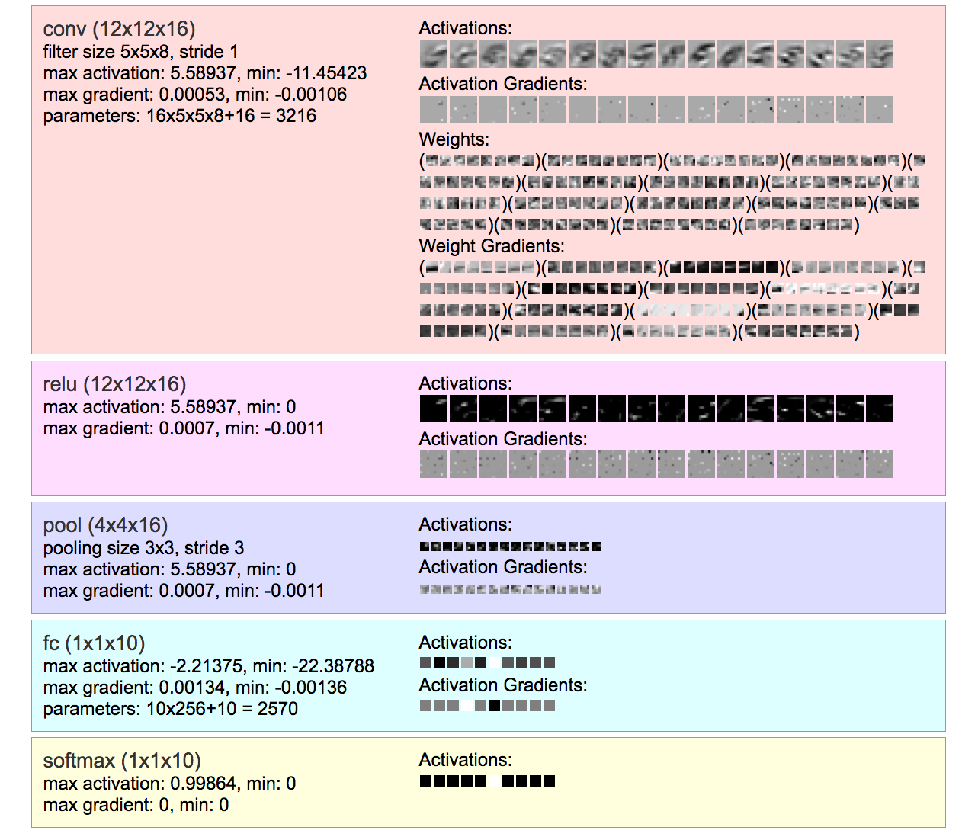
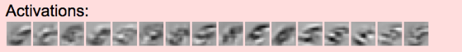
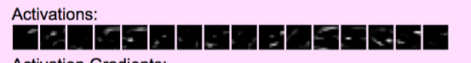
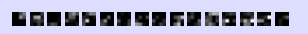

Slide 42
Why do max-pooling?
Saves space
Reduces overfitting?
Because I’m going to add more convolutions after it!
Allows the short-range convolutions to extend over larger subfields of the images
So we can spot larger objects
Eg, a long horizontal line, or a corner, or …
At some point the feature maps start to get very sparse and blobby – they are indicators of some semantic property, not a recognizable transformation of the image
Then just use them as features in a “normal” ANN

Slide 45
Why do max-pooling?
Saves space
Reduces overfitting?
Because I’m going to add more convolutions after it!
Allows the short-range convolutions to extend over larger subfields of the images
So we can spot larger objects
Eg, a long horizontal line, or a corner, or …

Slide 46
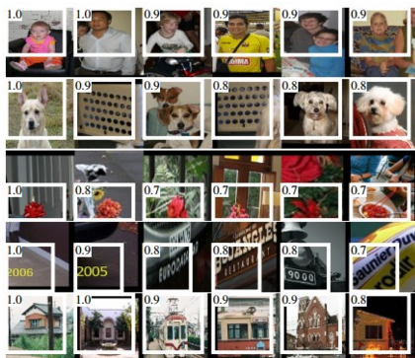
Alternating convolution and downsampling
5 layers up
The subfield in a large dataset that gives the strongest output for a neuron

Slide 47
Outline
What’s new in ANNs in the last 5-10 years?
Deeper networks, more data, and faster training
Scalability and use of GPUs ✔
Symbolic differentiation ✔
Some subtle changes to cost function, architectures, optimization methods ✔
What types of ANNs are most successful and why?
Convolutional networks (CNNs) ✔
Long term/short term memory networks (LSTM)
Word2vec and embeddings
What are the hot research topics for deep learning?

Slide 48
Recurrent Neural Networks

Slide 49
Motivation: what about sequence prediction?
What can I do when input size and output size vary?

Slide 50
Motivation: what about sequence prediction?
h
A
x

Slide 51
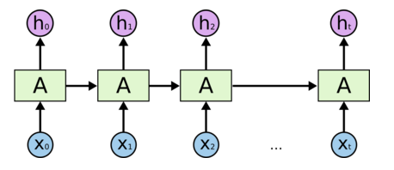
Architecture for an RNN
Some information is passed from one subunit to the next
Sequence of outputs
Sequence of inputs
Start of sequence marker
End of sequence marker
http://colah.github.io/posts/2015-08-Understanding-LSTMs/

Slide 52
Architecture for an 1980’s RNN
…
Problem with this: it’s extremely deep and very hard to train

Slide 53
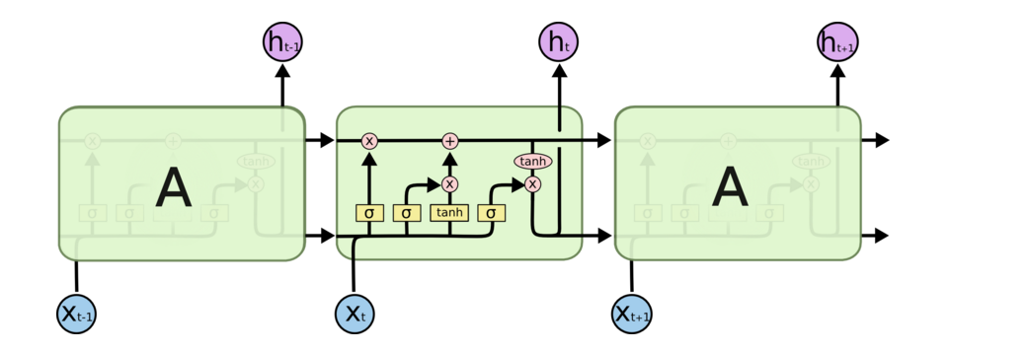
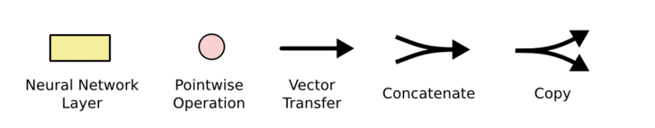
Architecture for an LSTM
“Bits of memory”
Decide what to forget
Decide what to insert
Longterm-short term model
Combine with transformed x_{t}
σ: output in [0,1]
tanh: output in [-1,+1]
http://colah.github.io/posts/2015-08-Understanding-LSTMs/
Notes:
Info is transferred down the chain, not just propagated
Decide when to insert imformation from input into the “backbone”

Slide 54
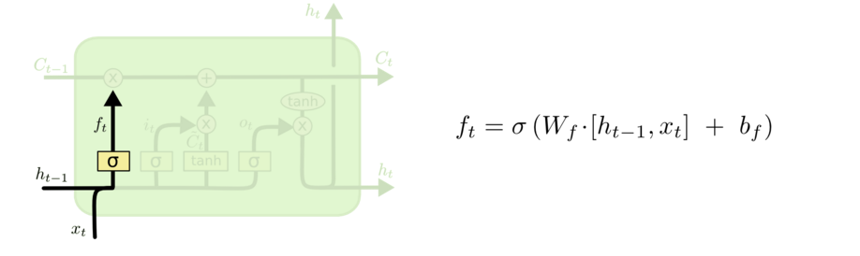
Walkthrough
What part of memory to “forget” – zero means forget this bit

Slide 55
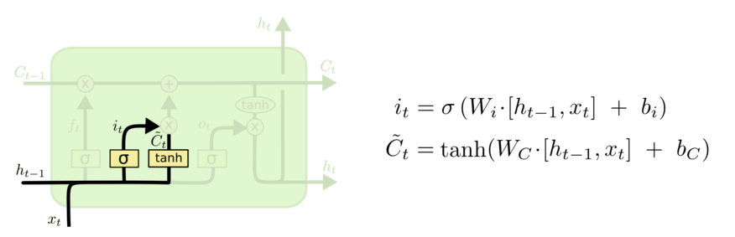
Walkthrough
What bits to insert into the next states
What content to store into the next state
http://colah.github.io/posts/2015-08-Understanding-LSTMs/

Slide 56
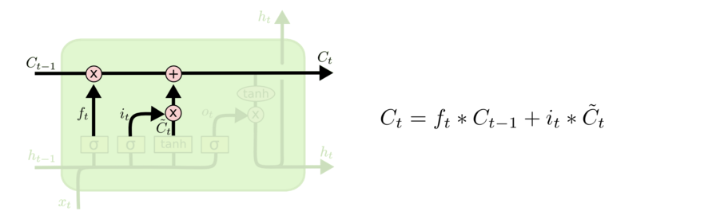
Walkthrough
Next memory cell content – mixture of not-forgotten part of previous cell and insertion
http://colah.github.io/posts/2015-08-Understanding-LSTMs/

Slide 57
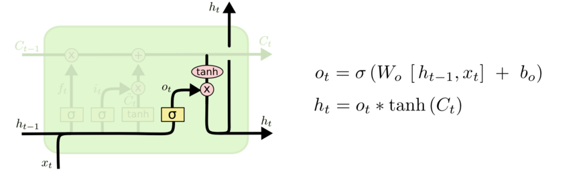
Walkthrough
What part of cell to output
tanh maps bits to [-1,+1] range
http://colah.github.io/posts/2015-08-Understanding-LSTMs/

Slide 58
Architecture for an LSTM
(1)
(2)
C_{t-1}
(3)
i_{t}
o_{t}
f_{t}
http://colah.github.io/posts/2015-08-Understanding-LSTMs/
Notes:
Info is transferred down the chain, not just propagated
Decide when to insert imformation from input into the “backbone”

Slide 59
Implementing an LSTM
For t = 1,…,T:
(1)
(2)
(3)
http://colah.github.io/posts/2015-08-Understanding-LSTMs/
Notes:
Info is transferred down the chain, not just propagated
Decide when to insert imformation from input into the “backbone”

Slide 60
Some Fun LSTM Examples
http://karpathy.github.io/2015/05/21/rnn-effectiveness/

Slide 61
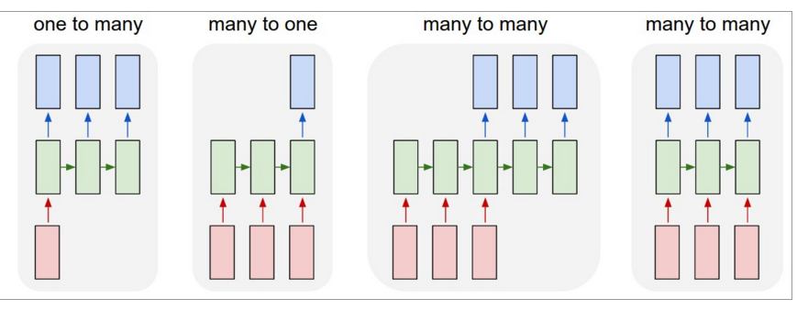
LSTMs can be used for other sequence tasks
image captioning
sequence classification
named entity recognition
translation
http://karpathy.github.io/2015/05/21/rnn-effectiveness/

Slide 62
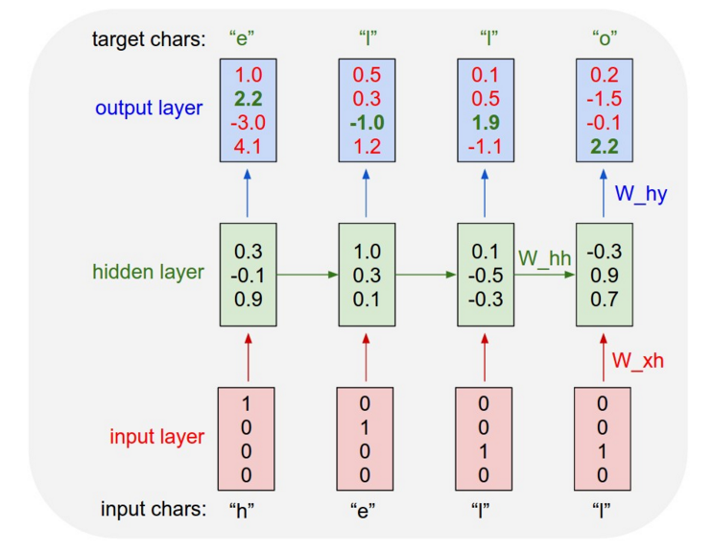
Character-level language model
Test time:
pick a seed character sequence
generate the next character
then the next
then the next …
http://karpathy.github.io/2015/05/21/rnn-effectiveness/

Slide 63
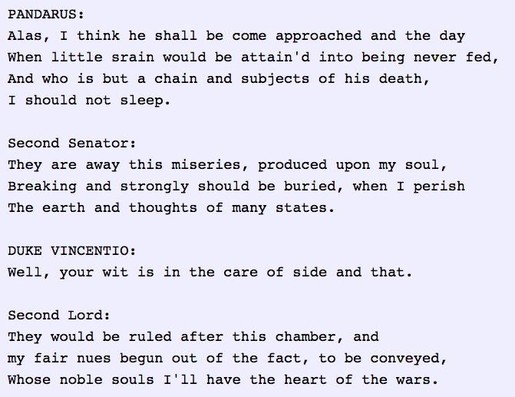
Character-level language model
http://karpathy.github.io/2015/05/21/rnn-effectiveness/

Slide 64
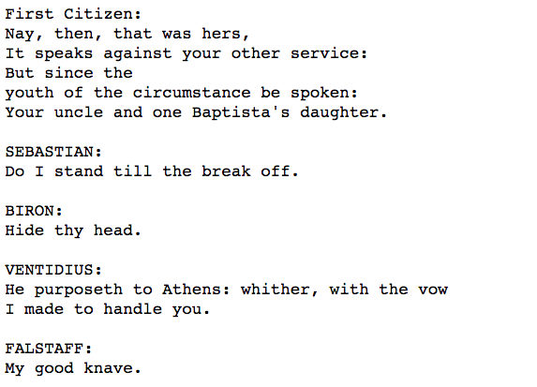
Character-level language model
Yoav Goldberg:
order-10 unsmoothed character n-grams
http://karpathy.github.io/2015/05/21/rnn-effectiveness/

Slide 65
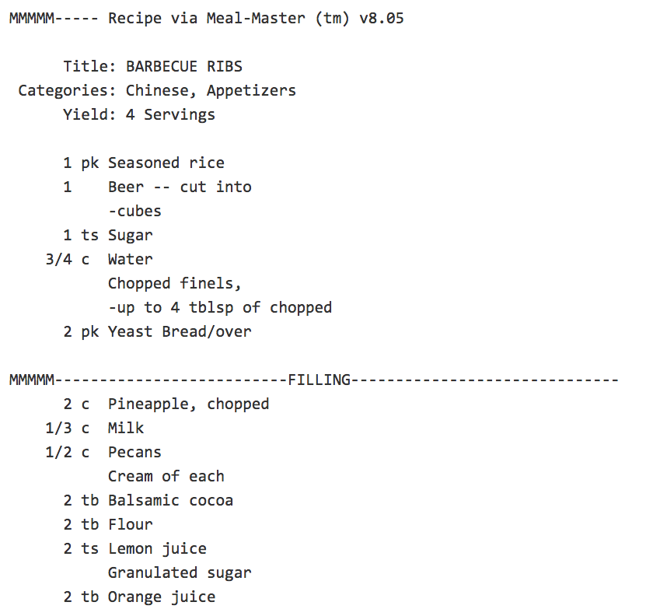

Character-level language model
http://karpathy.github.io/2015/05/21/rnn-effectiveness/

Slide 66

Character-level language model
LaTeX “almost compiles”
http://karpathy.github.io/2015/05/21/rnn-effectiveness/

Slide 67

Character-level language model
http://karpathy.github.io/2015/05/21/rnn-effectiveness/

Slide 68
Outline
What’s new in ANNs in the last 5-10 years?
Deeper networks, more data, and faster training
Scalability and use of GPUs ✔
Symbolic differentiation ✔
Some subtle changes to cost function, architectures, optimization methods ✔
What types of ANNs are most successful and why?
Convolutional networks (CNNs) ✔
Long term/short term memory networks (LSTM)
Word2vec and embeddings
What are the hot research topics for deep learning?

Slide 69

Word2Vec and Word embeddings

Slide 70

Basic idea behind skip-gram embeddings
construct hidden layer that “encodes” that word
So that the hidden layer will predict likely nearby words w(t-K), …, w(t+K)
from an input word w(t) in a document
final step of this prediction is a softmax over lots of outputs

Slide 71
Basic idea behind skip-gram embeddings
Training data:
positive examples are pairs of words w(t), w(t+j) that co-occur
You want to train over a very large corpus (100M words+) and hundreds+ dimensions
Training data:
negative examples are samples of pairs of words w(t), w(t+j) that don’t co-occur

Slide 72

Results from word2vec
https://www.tensorflow.org/versions/r0.7/tutorials/word2vec/index.html

Slide 73

Results from word2vec
https://www.tensorflow.org/versions/r0.7/tutorials/word2vec/index.html

Slide 74

Results from word2vec
https://www.tensorflow.org/versions/r0.7/tutorials/word2vec/index.html

Slide 75
Outline
What’s new in ANNs in the last 5-10 years?
Deeper networks, more data, and faster training
Scalability and use of GPUs ✔
Symbolic differentiation ✔
Some subtle changes to cost function, architectures, optimization methods ✔
What types of ANNs are most successful and why?
Convolutional networks (CNNs) ✔
Long term/short term memory networks (LSTM)
Word2vec and embeddings
What are the hot research topics for deep learning?

Slide 76
Some current hot topics
Multi-task learning
Does it help to learn to predict many things at once? e.g., POS tags and NER tags in a word sequence?
Similar to word2vec learning to produce all context words
Extensions of LSTMs that model memory more generally
e.g. for question answering about a story

Slide 77
Some current hot topics
Optimization methods (>> SGD)
Neural models that include “attention”
Ability to “explain” a decision

Slide 78


Examples of attention
https://papers.nips.cc/paper/5542-recurrent-models-of-visual-attention.pdf

Slide 79

Examples of attention
Basic idea: similarly to the way an LSTM chooses what to “forget” and “insert” into memory, allow a network to choose a path to focus on in the visual field
https://papers.nips.cc/paper/5542-recurrent-models-of-visual-attention.pdf

Slide 80
Some current hot topics
Knowledge-base embedding: extending word2vec to embed large databases of facts about the world into a low-dimensional space.
TransE, TransR, …
“NLP from scratch”: sequence-labeling and other NLP tasks with minimal amount of feature engineering, only networks and character- or word-level embeddings

Slide 81
Some current hot topics
Computer vision: complex tasks like generating a natural language caption from an image or understanding a video clip
Machine translation
English to Spanish, …
Using neural networks to perform tasks
Driving a car
Playing games (like Go or …)

